Slide 1
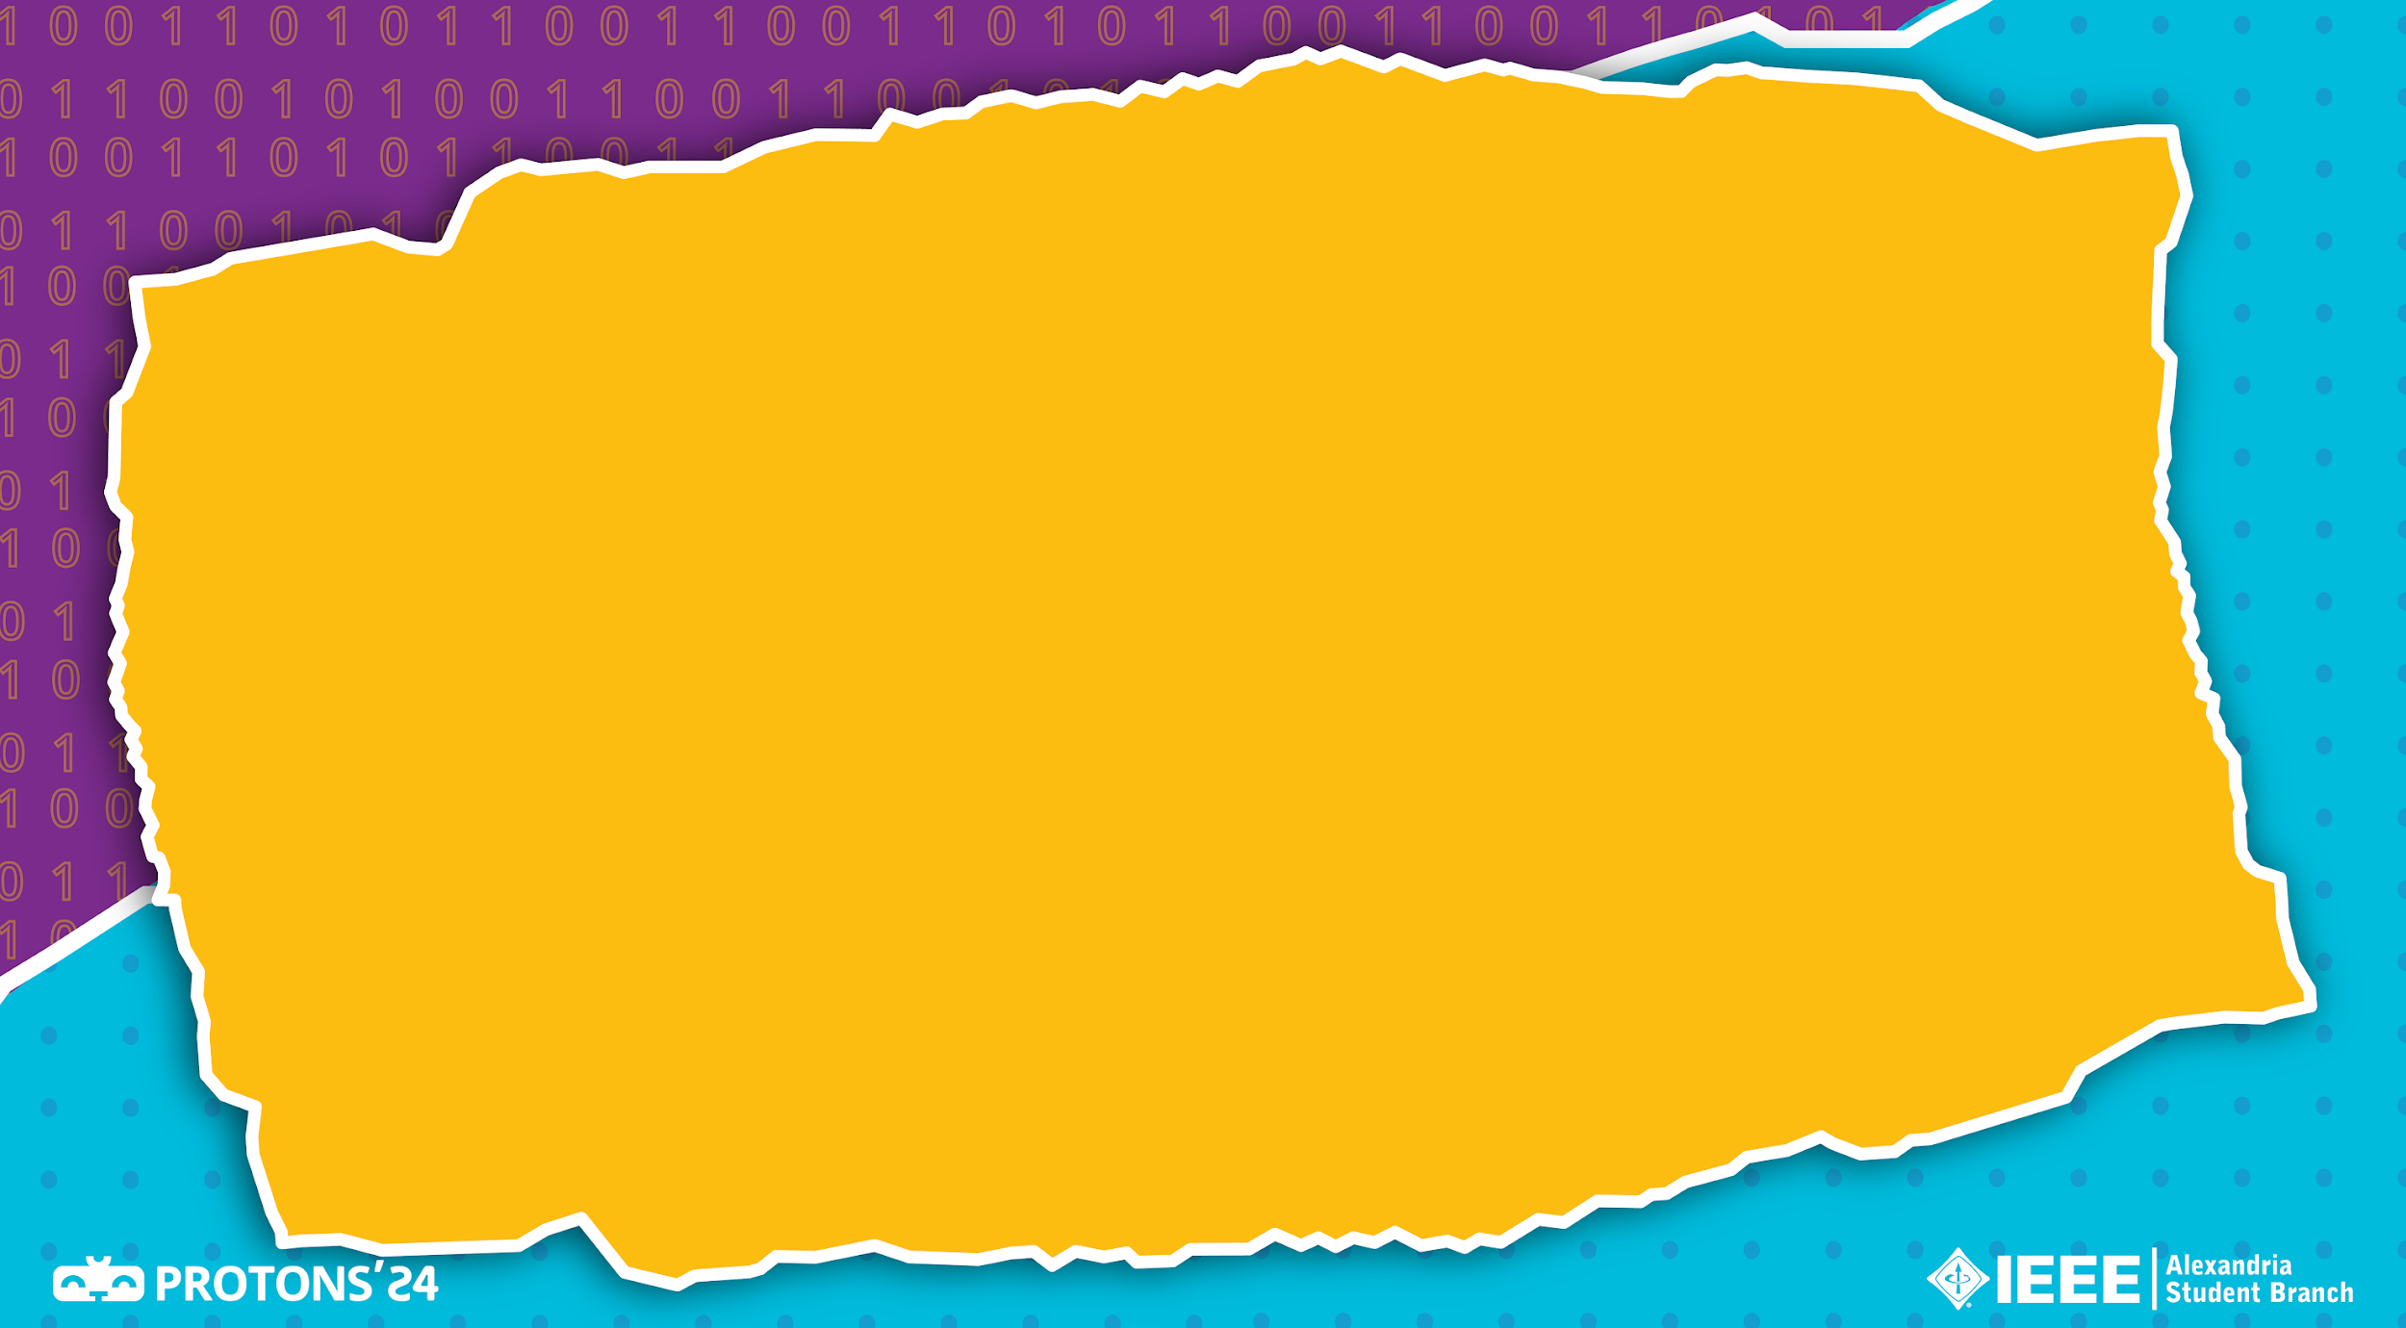

Errors
By Yahia Islam

Slide 2
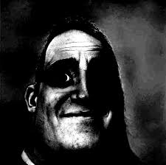

Slide 3
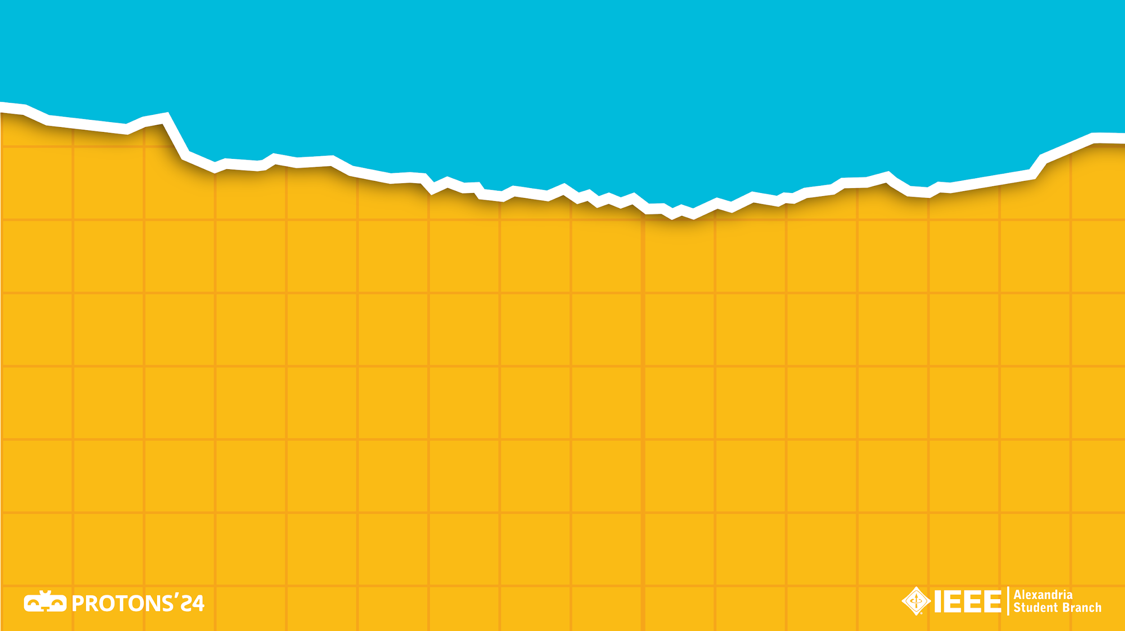
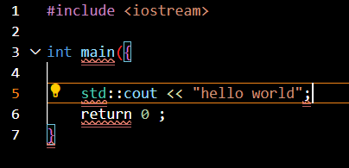
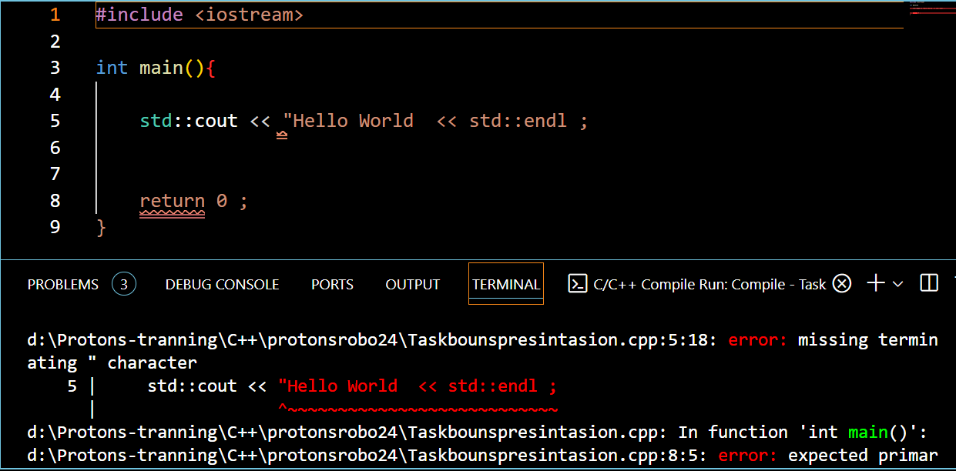
Syntax Errors
1. Bracers
2.Quotation Marks

Slide 4
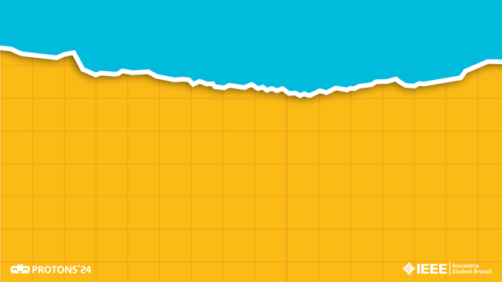
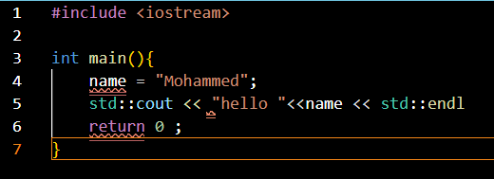
Syntax Errors

Slide 5
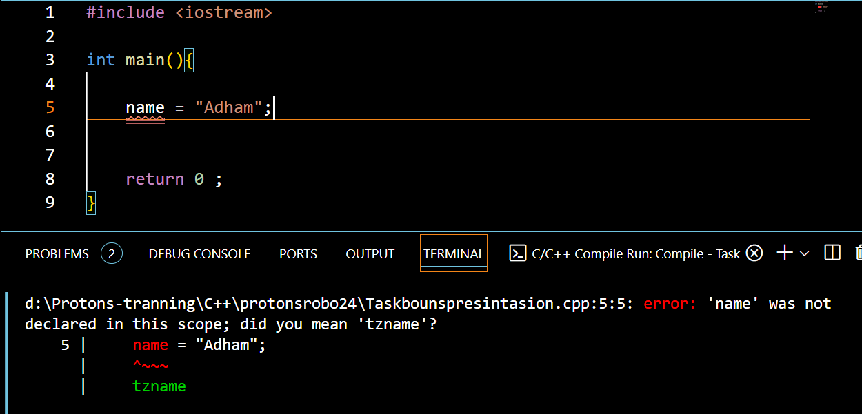
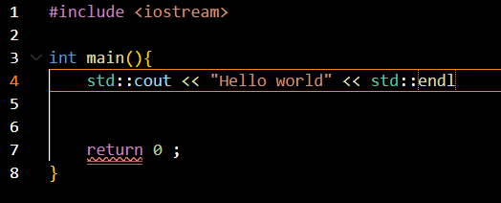
Syntax Errors
3. Semicolons
3. Names

Slide 6
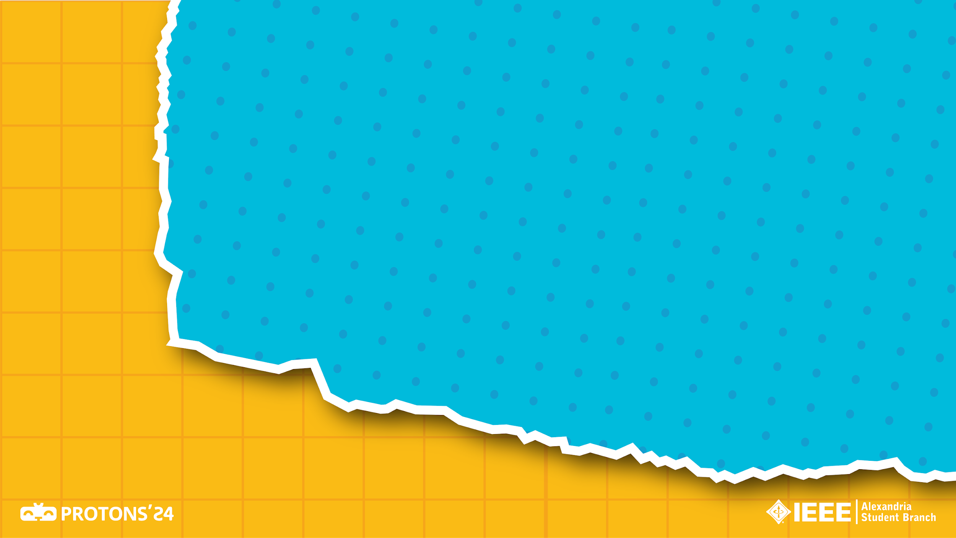
Logic Error
An error in the logic of the program that causes it to behave not as intended !

Slide 7

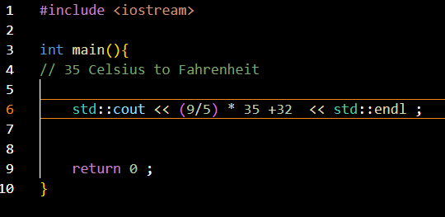

Slide 8
Output : 67
Correct answer: 95

Slide 9
Runtime Error
1.Division by zero
2.Overflow
3.File not existed

Slide 10
